Slide 1
Known Pathogenic Variant Prioritization (KPVP)
Interpreted Genome changes:
Info for TPIs
Referral used as current reference: r21883298454 which ran through the production pipeline in December 2022

Slide 2
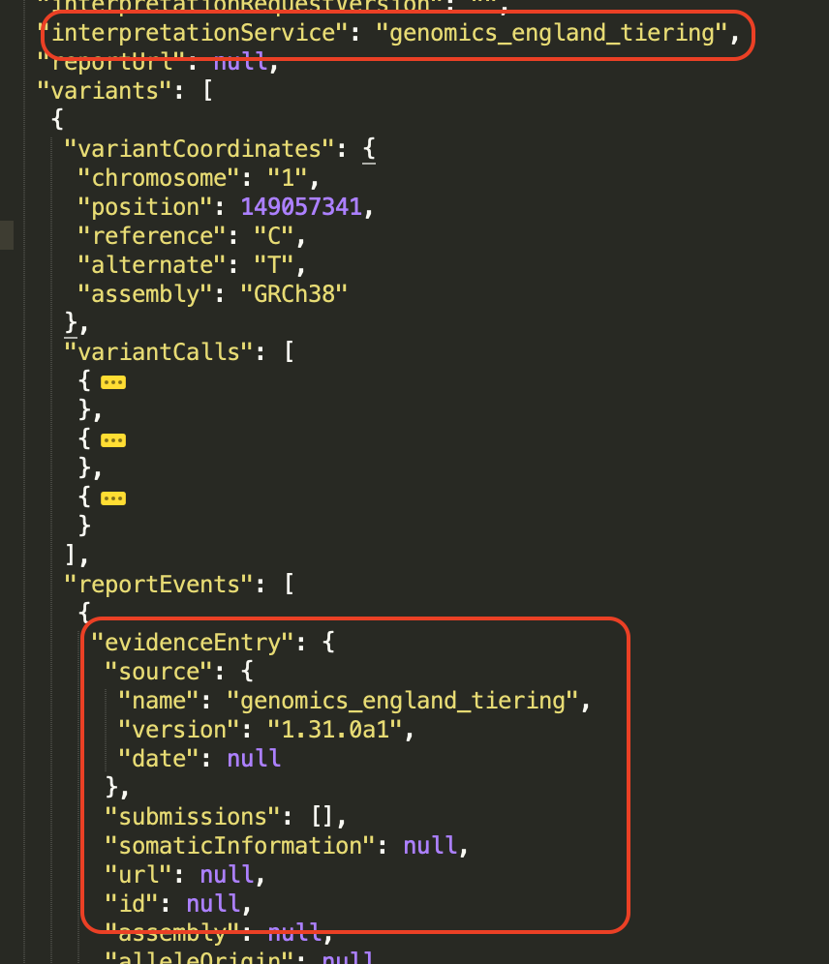
Known Pathogenic Variant Prioritization (KPVP)
KPVP improves the sensitivity of the Genomics England tiering pipeline, by prioritising known disease pathogenic variants that would otherwise be filtered out by tiering rules
To support KPVP - report events within “genomics_england_tiering” Interpreted Genomes will have some additional fields ‘added’
Nothing is being removed

Slide 3
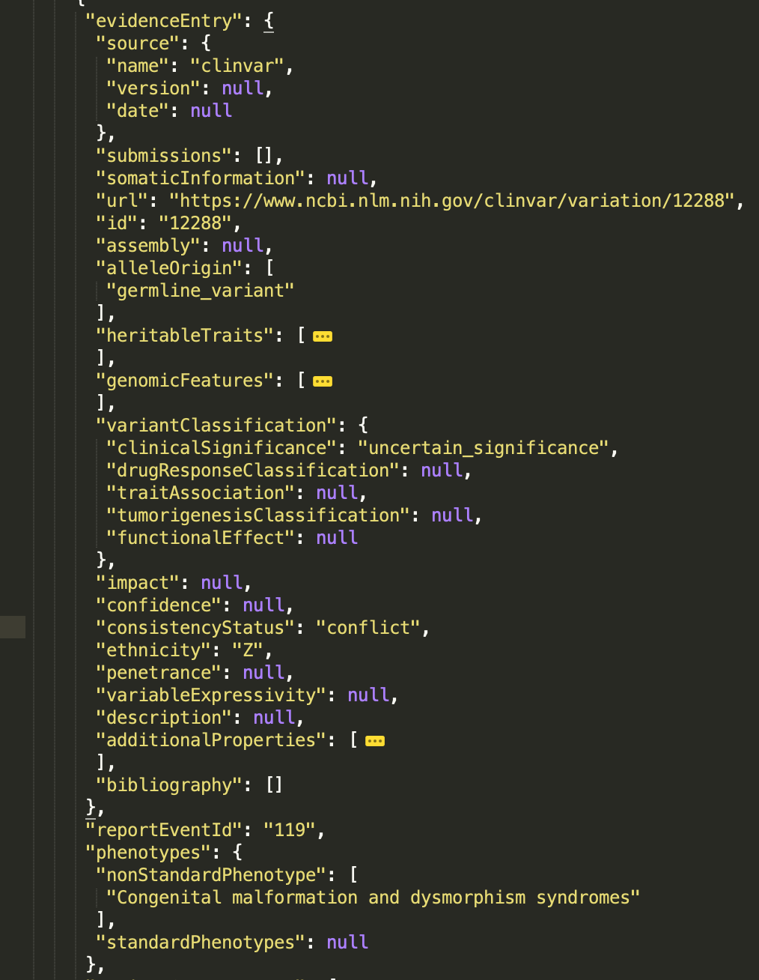
Variants: reportEvents
NEW! `evidenceEntry`
Can be null
The new evidence entry includes the reason why the report event was generated
  genomic_england_tiering – current rules
  genomic_england_tiering_small_variant_inclusion_list – variant on the inclusion list
  clinvar – clinvar vcv entry that meets criteria for generating known pathogenic report event

Slide 4
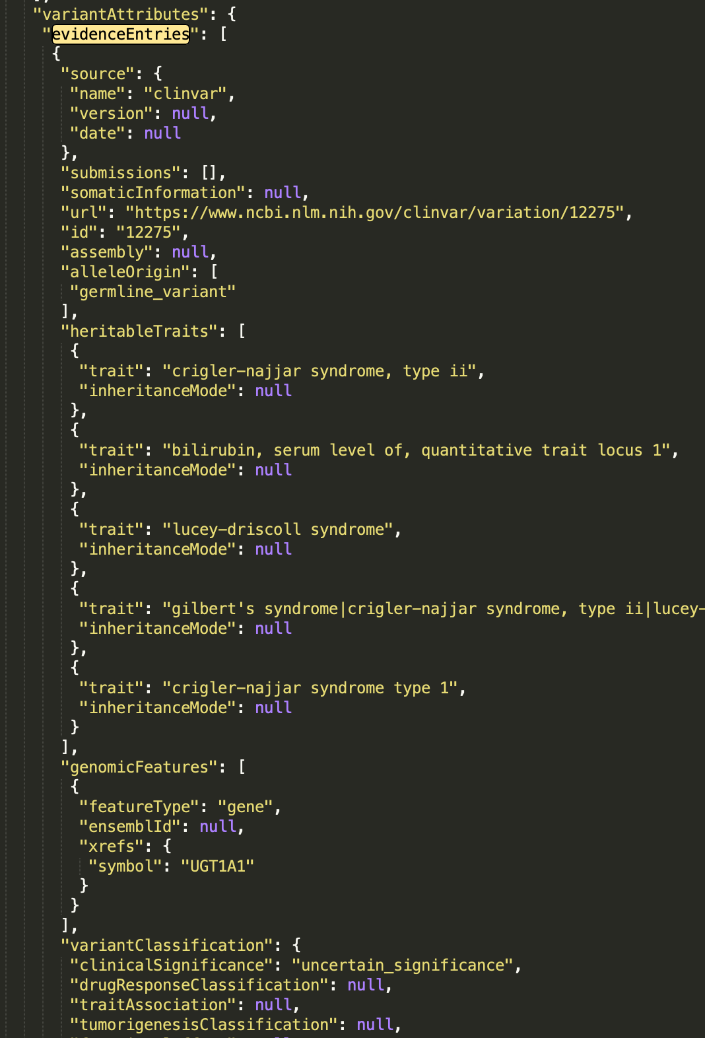
Variants: variantAttributes
NEW! `evidenceEntries`
Can be null or an empty list
All evidences (clinvar) associated with the variant

Slide 5
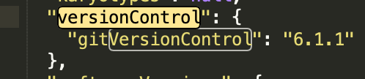
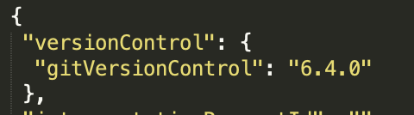
versionControl
Currently
After KPVP
KPVP uses GRM “reports” 6.4.0

Slide 6
Things that haven’t changed
There’s no KPVP for structuralVariants or shortTandemRepeats so the variants and report events will be the same
Exomiser Interpreted Genomes are staying the same

